Slide 1
Literature review for “Imagenet-trained CNNs are Biased towards Texture” (Geirhos et al., 2019)
2020.12

Slide 2
Outline
Summary
Highlights

Slide 3
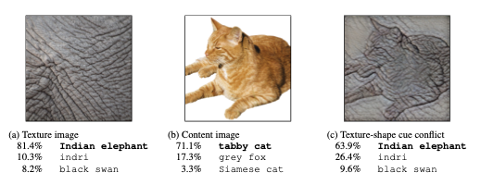
The problem
There are conflicting hypotheses that CNNs are representing more towards shapes or textures. The paper tried to quantify that.
ImageNet trained CNNs are strongly biased towards recognizing textures rather than shapes.
Figure 1: By mixing elephant texture with cat image, CNNs classify it as elephant in (c). (Geirhos et al., 2019)

Slide 4
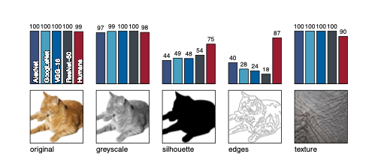
The experiment
Texture vs Shape bias in humans and ImageNet-trained CNNs
Object and texture images handles well
Greyscale images handles well, as it still contain both shape and texture
CNNs cannot handle silhouette images and edges images well (no texture information)
Figure 2: Accuracies for five different experiments (Geirhos et al., 2019)

Slide 5
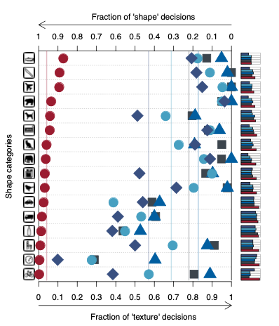
The experiment
CNNs mostly recognize textures, not shapes
Human observers (red) recognize image more based on shape.
AlexNet (purple diamonds), VGG16 （blue triangles) and ResNet-50 (grey squares) are more based on texture.
Figure 4: Classification result using IN (Geirhos et al., 2019)

Slide 6
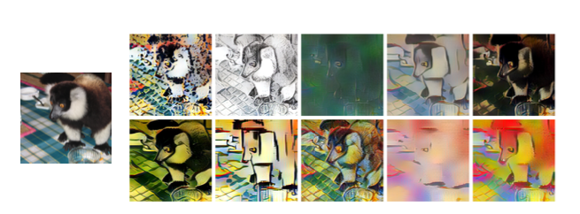
The experiment
ImageNet (IN) might simply suffice to integrate evidence from many local texture features rather than classifying global shapes.
Using Stylized-ImageNet (SIN)
Figure 3: Stylized-ImageNet (SIN), ten different painting texture to a random ImageNet image (Geirhos et al., 2019)

Slide 7
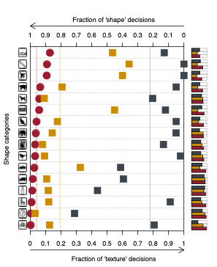
The experiment
SIN (orange squares) are more towards shape comparing to IN (grey squares)
Figure 6: Classification result using IN and SIN (Geirhos et al., 2019)

Slide 8
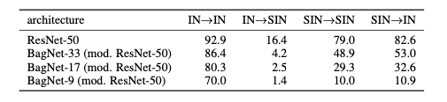
The experiment
Training alone with SIN is harder, since textures are no longer predictive
Standard ResNet-50 trained on SIN with 79.0% top-5 accuracy, lower than 92.9% on IN.
ImageNet features generalize poorly to SIN (16.4%)
SIN features generalize well to IN (82.6%)
Network: BagNets (ResNet-50 architecture with maximum receptive field size is limited to 9x9, 17x17 or 33x33)
Figure 5: Top-5 accuracy comparison with training data -> testing data (Geirhos et al., 2019)

Slide 9
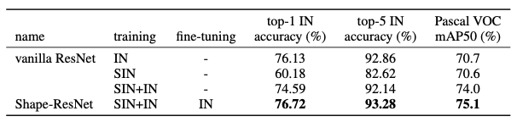
The experiment
Training alone with SIN is harder, since textures are no longer predictive
Standard ResNet-50 trained on SIN with 79.0% top-5 accuracy, lower than 92.9% on IN.
ImageNet features generalize poorly to SIN (16.4%)
SIN features generalize well to IN (82.6%)
Network: BagNets (ResNet-50 architecture with maximum receptive field size is limited to 9x9, 17x17 or 33x33)
Figure 5: Accuracy comparison with IN as validation data (Geirhos et al., 2019)

Slide 10
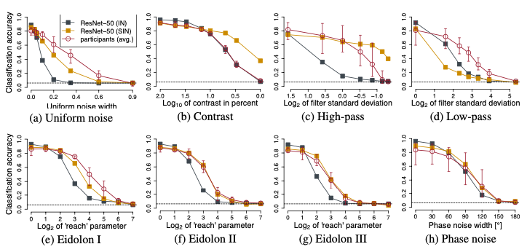
The experiment
Figure 5: Classification accuracy comparison on disorted images (Geirhos et al., 2019)

Slide 11
Conclusion
Shape is much robust than textures.
Like snowing, raining, will actually impact textures of the image, adding noise
Emergent noise robustness: no corruption seen during training
Adversarial is not changed too much (still future work)

Slide 12
Highlights
Design a series of experiments that demonstrate ImageNet-trained CNNs are bias towards texture, not shape.
Using Styled-ImageNet enables CNNs learning from shape
Improvement of robustness by learning shape information

